Slide 1

SSWD – Project Presentation
The SMO
Mert Kaya, Oguz Sarac, Sergey Kurapov

Slide 2
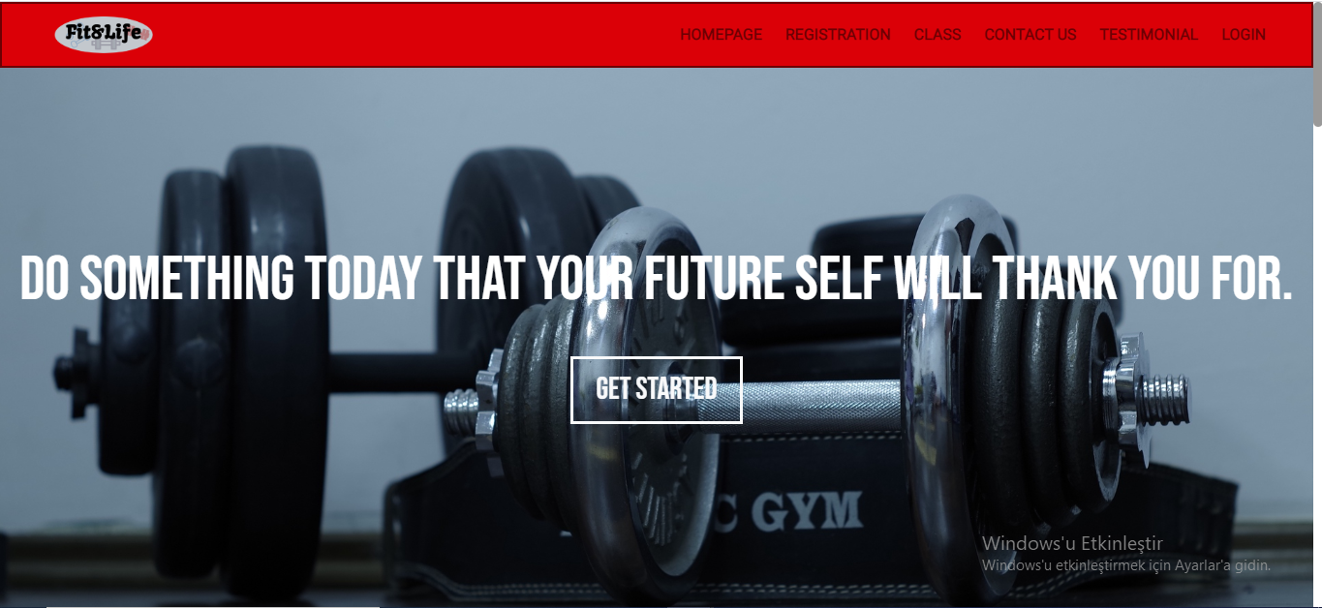
Visual Design

Slide 3
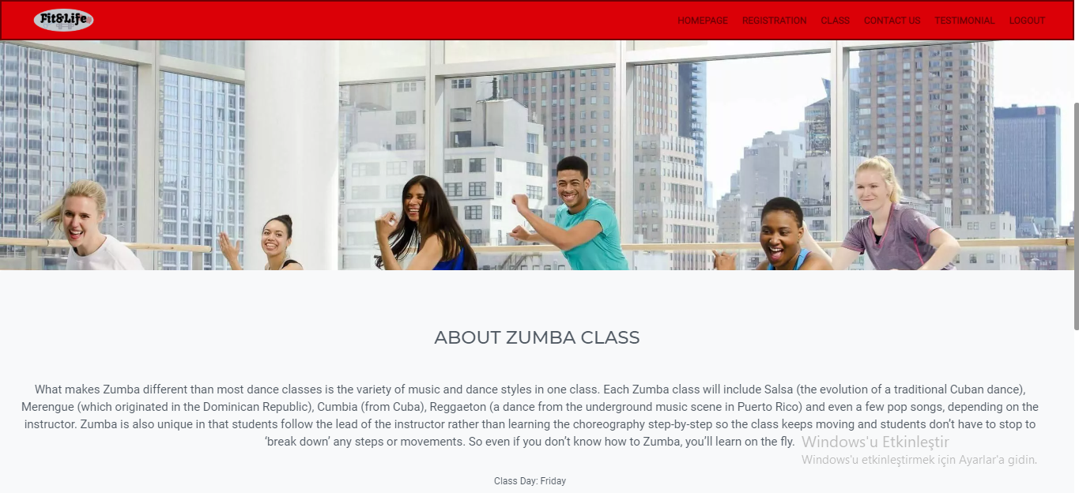
Visual Design

Slide 4
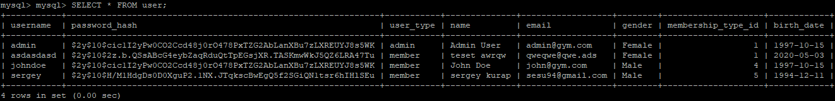
Private Section

Slide 5
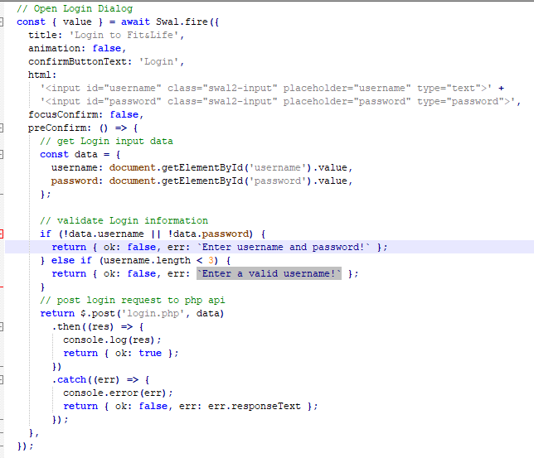
Private Section

Slide 6
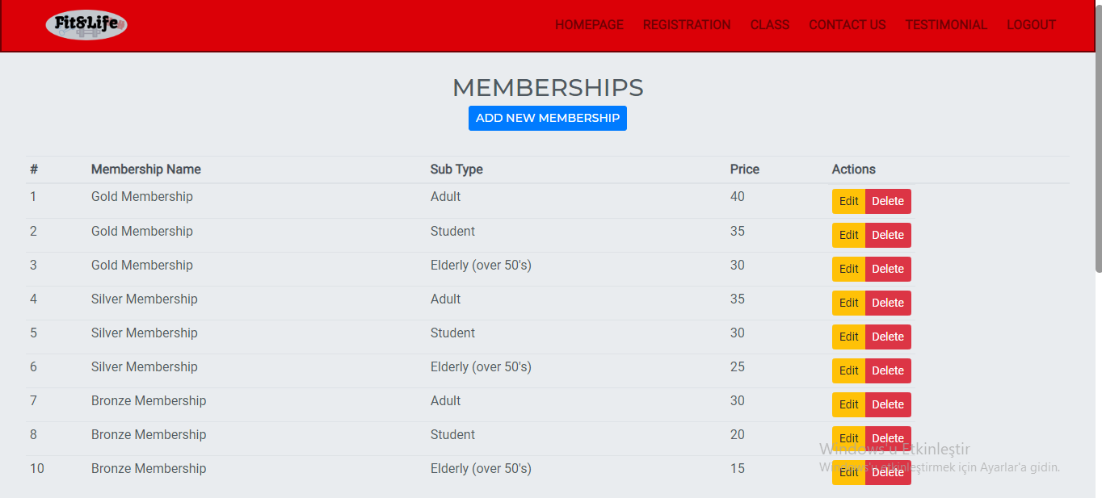
Member/Admin

Slide 7
Technologies Used
Technologies Used | Description
Php | The php played main role in our code for linking our code with sql, listing our tables and so on. It is help us also for Server-side scripting.
SweetAlert2 | We used our pop-up boxes customization by using SweetAlert2 Library that we used to create login pop-up’s.
Bootstrap | We used Bootstrap to have a better view for our website. (spacing, padding, card, button and more…)
CSS | We used Cascading Style Sheet(CSS). Navigation bar-Footer colouring, designing, and forming the pages was a main role.
MySQL | r adding, accessing, and managing content in a database. It is most noted for its quick. It was an essential part for PHP.
HTML | We used to HTML for building our skeleton for the pages.
Javascript | We build our function by using Javascript.

Slide 8
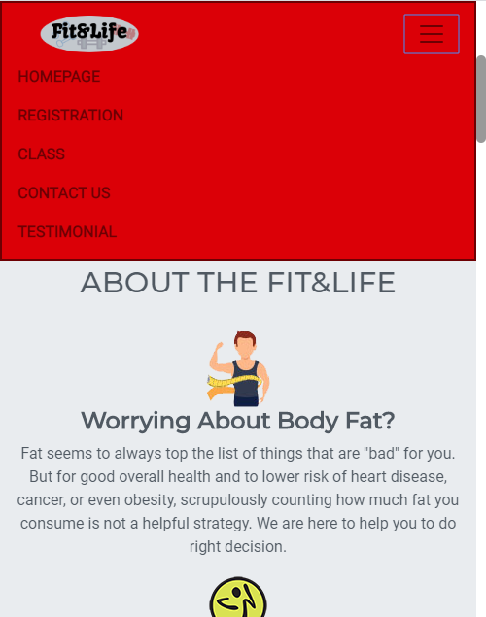
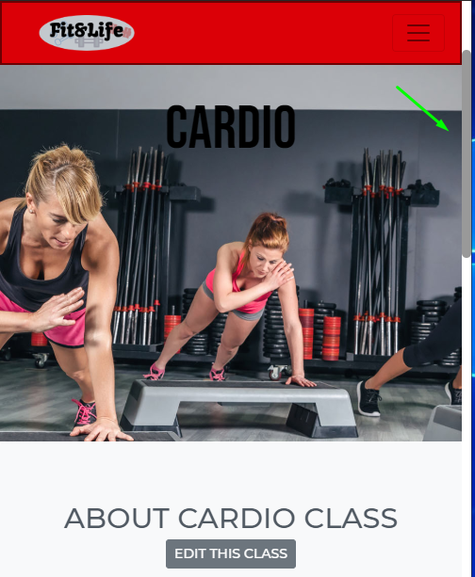
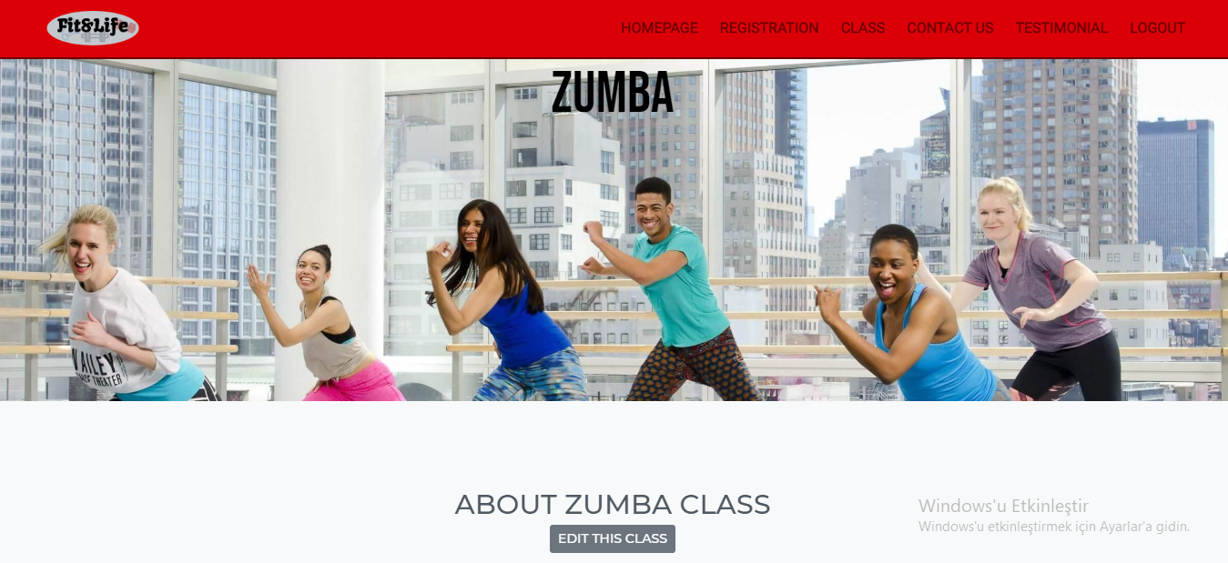
Extra Feature(s)
Here is a screenshot of Responsive Version(Mobile friendly).
Here is a screenshot of Responsive Version(Mobile friendly).
Here is a custom scrollbar that we did.
You can enter specifically page for the classes(Pilates, Zumba etc.)

Slide 9
What is missing?
Features that we attempt | Description
data-spy="scroll" data-target="#menu” | We tried to show the heading in the navigation bar by using data-spy when we scroll down the page it was going to show the which heading are we at but since all headings are in different webpage we decided not to use it.

Slide 10
Features to Improve
Convert all images (.jpg - .png etc.) to .webp extension. It will help to the images for loading faster because it is compressed images and many top websites are using it.
If we create an social media accounts for our gym we can add the links (as a button) in to the footer. That means footer will be looking better.
We can have a look again to our css file there are few lines that we need to cleaned up because we are not going to use anymore. (E.g. Line 174 – 205)
The buttons for uploading image. We can technically and visually make it better at present.

